Slide 1



Understanding Topic Identification
Topic identification is a crucial first step in any research or writing process. It involves recognizing the central theme or subject that will drive the content. Whether for academic research, creative projects, or business endeavors, a clear and well-defined topic is essential for success.
by Anusha Reddy B

Slide 2



Importance of Topic Identification
Clarity and Focus
Elevated Engagement
Connection with Audience
Identifying the right topic provides clarity and focus, ensuring that the subsequent research or writing remains on track and delivers a cohesive message to the audience.
A well-chosen topic captivates the audience, encouraging them to delve deeper into the content and find relevance in the message being conveyed.
The right topic resonates with the target audience, building a strong connection and fostering meaningful engagement.

Slide 3

Methods for Identifying a Topic
1
Brainstorming
Engage in brainstorming sessions to generate a wide range of potential topics, allowing creativity to flow freely without limitations.
2
Research and Analysis
Undertake thorough research and analysis to identify trending issues, gaps in existing knowledge, or emerging areas of interest.
3
Consultation
Seek input and advice from mentors, colleagues, or peers to gain diverse perspectives and insights that may spark ideas for potential topics.

Slide 4
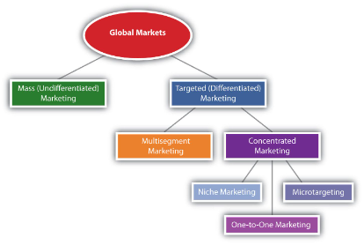
Factors to Consider When Choosing a Topic
Relevance
Feasibility
Passion and Expertise
Assess the relevance of the topic to the target audience, ensuring that it aligns with their interests, needs, and aspirations.
Evaluate the feasibility of exploring the chosen topic, considering factors such as available resources, time constraints, and access to relevant information.
Ensure that the chosen topic aligns with personal passion and expertise, enabling an authentic and impactful exploration of the subject matter.

Slide 5

Examples of Effective Topic Identification
1
Tackling Global Challenges
2
Exploring Cultural Narratives
Identification of topics related to climate change, sustainable development, and social equity, leading to impactful research and action.
Identification of topics that celebrate diverse cultural narratives, fostering understanding and appreciation across communities.
3
Innovative Technological Solutions
Identification of topics related to technological advancements, inspiring creative solutions and advancements in various industries.

Slide 6




Challenges in Topic Identification
Information Overload
Access to vast amounts of information can make it challenging to focus and select a specific, impactful topic for exploration.
Navigating Complexity
Some topics may be inherently complex, requiring additional effort to distill the core elements and communicate them effectively.
Shifting Trends
Rapidly changing trends and interests may make it difficult to identify topics that remain relevant and captivating over time.

Slide 7
Tips for Successful Topic Identification
Curiosity and Exploration
Interdisciplinary Perspectives
Cultivate a spirit of curiosity and exploration to discover unique and compelling topics that resonate with your interests and goals.
Seek interdisciplinary perspectives and insights to identify topics that bridge diverse fields and spark innovation.
Feedback and Iteration
Solicit feedback and engage in iterative processes to refine and enhance the chosen topic, ensuring its relevance and impact.

Slide 8
Conclusion
Topic Identification
Forms the foundation
of impactful research, writing, and exploration.
Mastering the art of topic identification unlocks opportunities for meaningful contribution and engagement, guiding endeavors towards success and significance.

